Slide 1
Secure Bridging Technology with Lock/Unlock
Bridging technology in blockchain enables the transfer of assets, like tokens, between different blockchains by locking and unlocking them. Here’s how it works:
When you want to move your tokens from one blockchain to another, you start by locking your tokens in a smart contract on the original blockchain. This means that the tokens are securely held and now become part of the token pool. Then, a message is sent to a corresponding smart contract on the destination blockchain. This contract responds by unlocking an equivalent amount of tokens on the destination chain, making them available for you to use there.
This locking and unlocking process ensures that the total number of tokens remains consistent across both blockchains, providing a secure and seamless way to transfer assets between different blockchain networks.

Slide 2

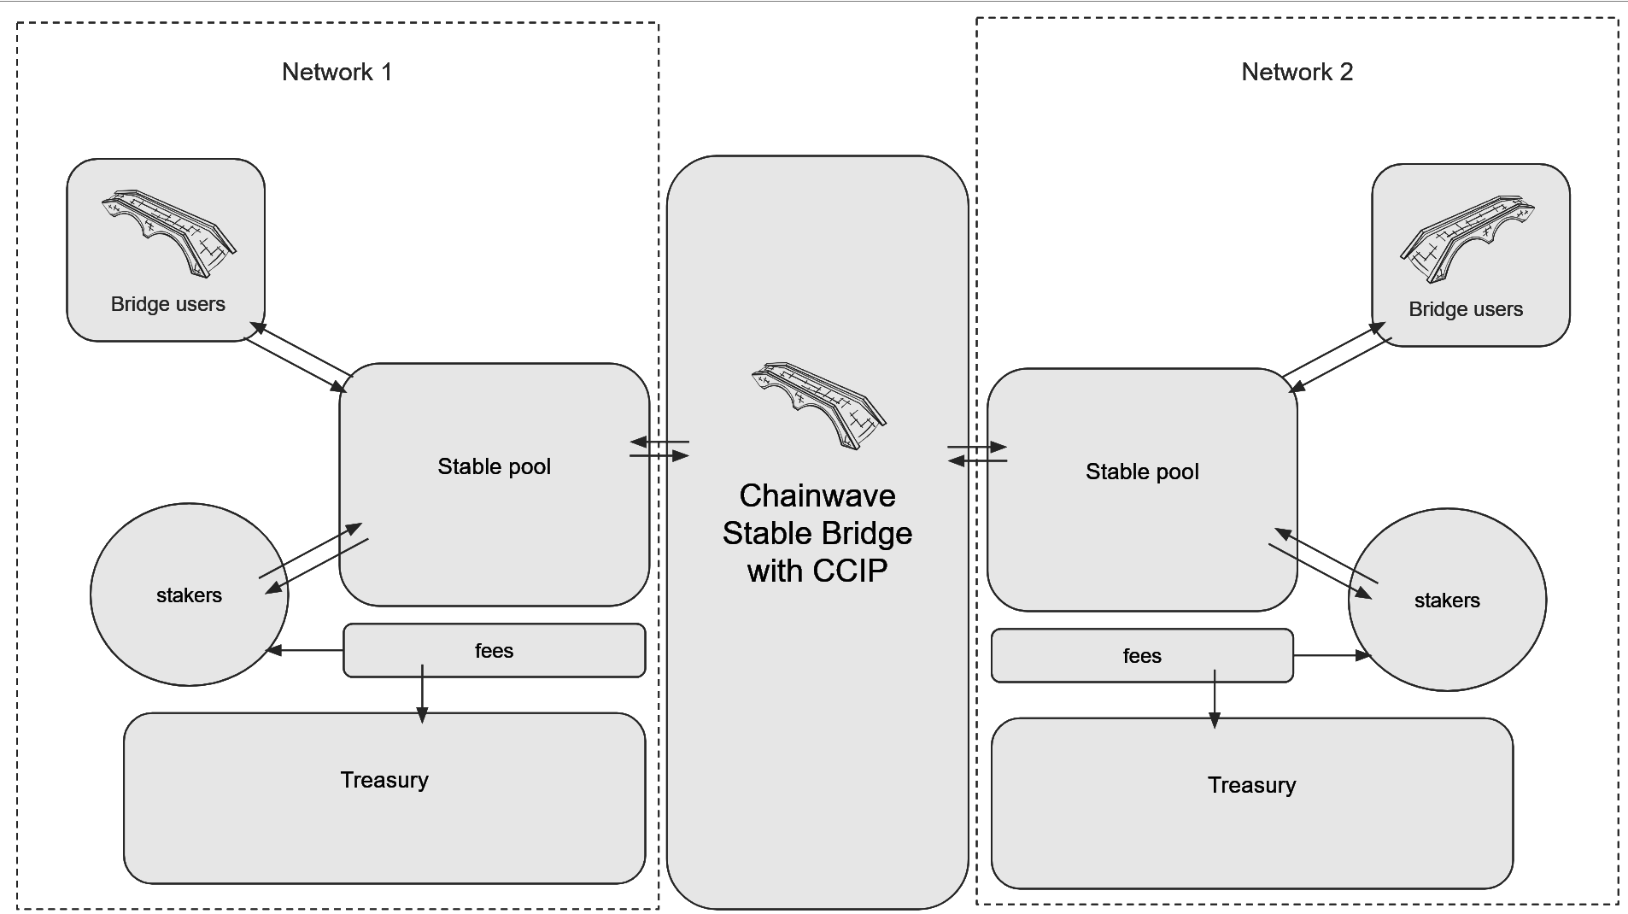
Chainwave Solutions CCIP Bridging Ideas with an existing Stable coin
Chainwave Solutions Development Ideas
A Stable Coin Bridge with additional staking combines cross-chain asset transfers with a dynamic staking mechanism, where user-staked tokens and project funds provide the liquidity needed for reliable bridge operations. The health factor ensures the pool stays balanced, enabling fast, secure transfers while rewarding users with staking returns. It’s a robust and efficient solution for decentralized finance.
Developer Fund Management:
Deposit and Withdrawal: The owner can deposit or withdraw funds from the contract, dynamically adjusting the pool's liquidity. This is useful for balancing the pools across different chains and ensuring the health of the system.
Impact on Health Factor: Any changes to the developer's stake (through deposits or withdrawals) will impact the pool’s health factor, ensuring that the system remains balanced.
User Interactions:
Staking: Users can stake tokens to contribute to the bridge liquidity pool and earn rewards from the fees generated by bridge transactions.
Unstaking: Users can unstake their tokens, provided the pool remains healthy, ensuring that sufficient liquidity is available for bridge operations.
Reward Claiming: Users can claim rewards earned from staking, which are derived from the bridge fees.
Integrated Staking for Bridge Operations:
Staking Pool Usage: The staking pool, along with the developer’s stake, is used to provide liquidity for bridge operations. This allows users interacting with the bridge to unlock tokens on the destination chain.
Health Factor Management:
Health Factor Monitoring: The health factor is calculated as the ratio of the developer's stake to the total user stakes. This ensures that the pool remains sufficiently funded and avoids over-reliance on user stakes.
Dynamic Health Factor Calculation: The calculateHealthFactor function dynamically calculates the health factor, which is used to monitor the pool's ability to support ongoing bridge transactions.

Slide 3
Why Stake with Chainwave
Users would stake their tokens in Chainwave's bridging system contracts to earn rewards from the fees generated by cross-chain transfers. By staking, users contribute to the liquidity pool that enables smooth and reliable asset transfers between blockchains. In return, they receive a portion of the bridge fees, providing them with a passive income stream.
Additionally, their participation helps maintain the health and efficiency of the bridge, ensuring that the system remains robust and secure for all users. This creates a win-win situation where users benefit financially while supporting a critical decentralized finance infrastructure.

Slide 4
Summary
This contract integrates staking with the bridge liquidity pool, allowing users to participate in both staking and bridging operations. The health factor mechanism ensures that the pool remains balanced and sufficiently funded to support bridge transactions, while the contract owner has the flexibility to manage funds dynamically. This system provides a robust framework for maintaining liquidity across chains, rewarding users, and ensuring the security and reliability of the bridge operations.

Slide 5
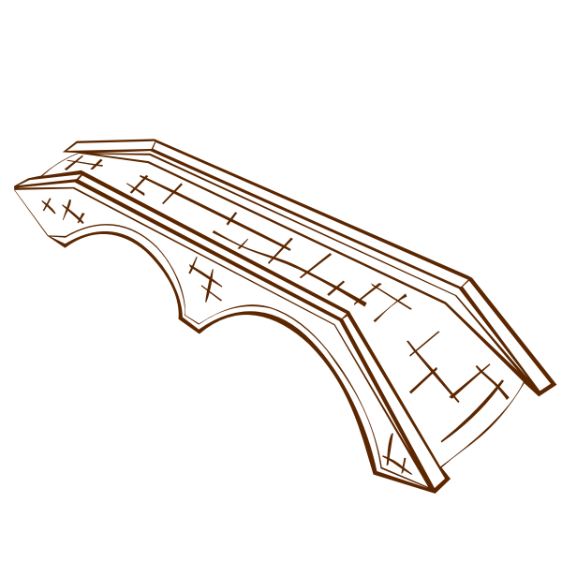
Network 1
Network 2
Chainwave Stable Bridge with CCIP
Bridge users
Bridge users
Stable pool
Stable pool
stakers
stakers
fees
fees
Treasury
Treasury

